Slide 1
Water Conservation/ Reuse Water
The City of Pooler promotes conservation through it Water Conservation Plan by:
Reuse Water
The City has the capacity to provide 1.0 MGD of reuse water from the WWTP to the Savannah Quarters Westbrook Golf Course, where it is used for irrigation. The City also has installed a reuse irrigation system for its 100 acre recreation site in the Godley Tract and has recently constructed a 4.22 miles of 10-inch Reuse FM to provide up to 800,00 gallons per day to the Nordic Cold Storage Facility.
Notes:
Williams-

Slide 2
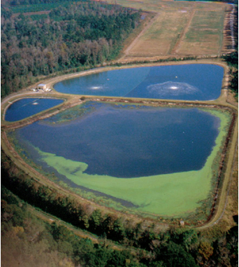
Wastewater Management
Former Pooler WWTP
0.98 MGD Capacity
Aerated Lagoons/ Overland Flow
Chlorine Disinfection
Effluent Discharged to Hardin Canal/Ogeechee River
Notes:
Winn-

Slide 3
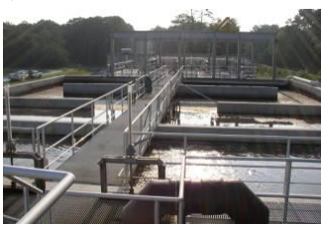
Wastewater Management
Waste Water Management is performed by the City of Pooler WWTP
New 2.5 MGD MBR WWTP Constructed in 2004
Expansion of MBR WWTP to 3.3 MGD by 2016
Build out to be 6.0 MGD
Notes:
Winn-

Slide 4
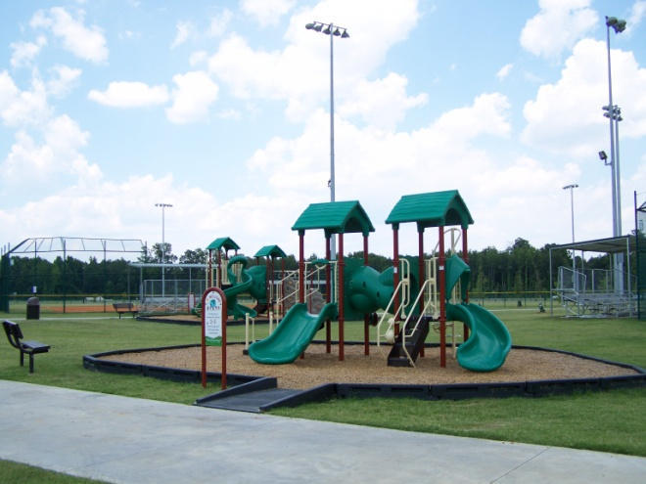
Reclaimed Water Use
Savannah Quarters Golf Course
Pooler Recreation Park
Nordic Cold Water Facility
Notes:
Winn-

Slide 5
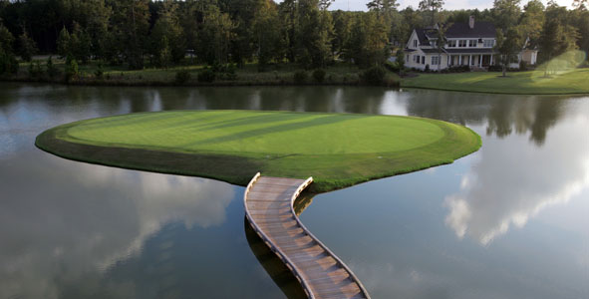
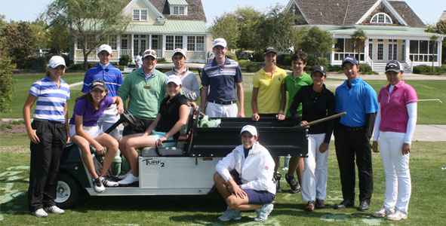
Reclaimed Water Use
Savannah Quarters Golf Course
- 13.5 million gallon storage pond
- City provides 1.0 MGD
Notes:
Winn-
150 Acre, 18 hole Greg Norman Signature Course.
Talk about the agreement: for every gallon of waste water the city receives, Savannah Quarters receives a gallon of reuse.
Talk about interconnected lagoons
The City of Pooler Provides up to 1.0 MGD of reuse water to the Savannah Quarter Golf Course. The reuse water is pumped from the Pooler WWTP through a 14-inch Reuse FM, 2.75 miles to a 13.5 million gallon storage pond located the intersection of interstate 16 and Pooler Parkway.

Slide 6
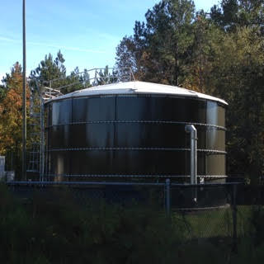
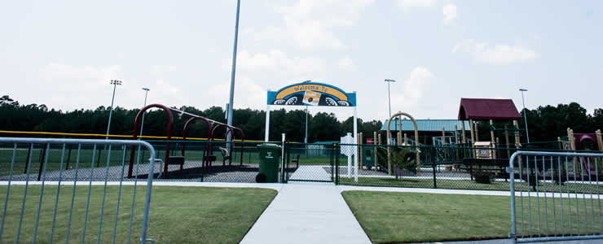
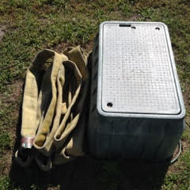
Reclaimed Water Use
Pooler Recreation Park
- 1.9 miles of 12-inch Reuse FM
- 120,000 gallon ground level storage tank
- Constructed in 2006/2007
Notes:
Winn-
Talk about the irrigation system, about the free reuse water available the public, about the purple signs
The City of Pooler also provide reuse water free of charge. A station is located at the north end of the Pooler Recreation Park, where anyone can obtain free reuse water
The purpose of the project was to provide reuse water for turf and landscape irrigation at the Pooler Recreation Park. The project consisted of 1.9 miles of 12-inch reuse FM and a 120,000 gallon storage tank.
.
.

Slide 7
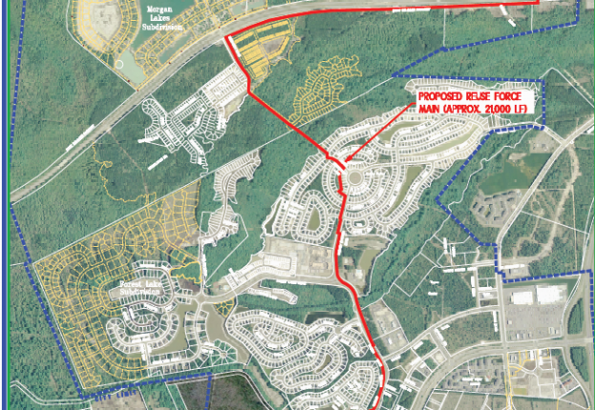
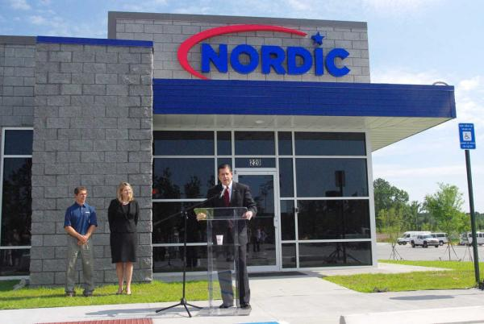
Reclaimed Water Use
Nordic Cold Storage Facility
- 4.22 miles of 10-inch Reuse FM
- 633,600 gallon storage pond
- Connected to existing 12-inch Reuse FM at Pooler Recreation Park
- Constructed in 2015/2016
Notes:
Winn/Maple-
The purpose of the project was to provide 800,000 GPD of reuse water to Nordic Cold Storage Facility. This project consisted of two extensions to the City of Pooler’s reuse water distribution system to provide reclaimed water to the City’s recreation park and the Nordic Cold Storage facility. The first project modified the existing reuse water force main at the City’s wastewater treatment plant to allow for water to be sent to both the original user, the Savannah Quarters Golf Club and the Recreation Park. The second project extended the reuse water system from the City’s Recreation Park to the Nordic Cold Storage Facility. .

