Slide 1
Informational Workshop 2018 Emergency Solutions Grants, HOPWA, and S+C Support Services Grants Application Process
March 2018
Office of Homeless and Special Needs

Slide 2
Workshop Content
Organizational Documents
Heather Smith and Christy Walker
ESG Application process & Introduction to HSOnline
Marion Goulbourne
Shelter + Care Application process
Libby Tyre, Danielle Jordon and Kate Tettamant
HOPWA Application process
Dr. Harvinder K Makkar and John Shereikis

Slide 3
Organizational Documents
March 2018
Heather Smith and Christy Walker

Slide 4
Objective
The requirements for fully completing the HSOnline Organizational Information of the 2018 ESG, HOPWA, and S+C Support Services Application

Slide 5
Background
Why do we collect this information?
Title 50. State Government
Chapter 20. Relations with Nonprofit Contractors
§50-20-1. Legislative intent
The General Assembly finds that the state has a right and a duty to monitor nonprofit organizations which contract with the state to ensure that their activities are in the public interest and to ensure that the public funds are used for proper purposes.

Slide 6
Background
Why do we collect this information?
§ 50-20-3. Requirements from nonprofit contractors; audits; political activities (a) Before entering into a financial agreement with a nonprofit organization, the head of the contracting state organization shall require the nonprofit organization to furnish financial and such other information as he or she may deem necessary to establish whether or not the nonprofit organization is financially viable and capable of providing services contemplated in the contract and that the agreement does not violate Chapter 10 of Title 45 related to conflicts of interest. Such information may include financial statements, Internal Revenue Service exempt status determination letters, Internal Revenue Service exempt organization information returns, and other related materials.

Slide 7
Background
§ 50-20-2. Definitions
(5) "Nonprofit organization" means any corporation, trust, association, cooperative, or other organization that is operated primarily for scientific, educational, service, charitable, or similar purposes in the public interest; is not organized primarily for profit; and uses its net proceeds to maintain, improve, or expand its operations. The term nonprofit organization includes nonprofit institutions of higher education and hospitals. For financial reporting purposes guidelines issued by the American Institute of Certified Public Accountants should be followed in determining nonprofit status.

Slide 8
Section 6: Organizations – Capacity Considerations
DCA is required by state law to perform due diligence around organizational capacity before making awards to nonprofit organizations. Funding decisions for non-profit agencies will be based, in part, on a review of the following:
The complexity or nature of the request;
Organizational structure, operating processes and capacity;
The extent to which the organization operates under the authority of a diversified, involved, volunteer, community-based board of directors;
Professional management;
The consistency of the organization’s identity or its mission to the provision of homeless or HIV (as applicable) services;

Slide 9
Section 6: Organizations – Capacity Considerations
The extent to which the organization utilizes networks to avoid duplication of housing and services;
Participation in appropriate provider groups and Continuums of Care;
Sound operating procedures, accounting policy and controls;
The presence and accuracy of financial management systems, accounts, funds, reports, tax returns, etc.;
Unrestricted financial resources available to the agency; and
Organizational and financial policy, controls, stability and capacity.

Slide 10
Organizational Documents Requested

Slide 11
Organizational Narrative
Complete the narrative for questions
1-5.
Please read the questions carefully and answer all aspects of each question.
This is your opportunity to provide brief but clear summaries about your organization and the work you do!

Slide 12
Organizational Narrative

Slide 13
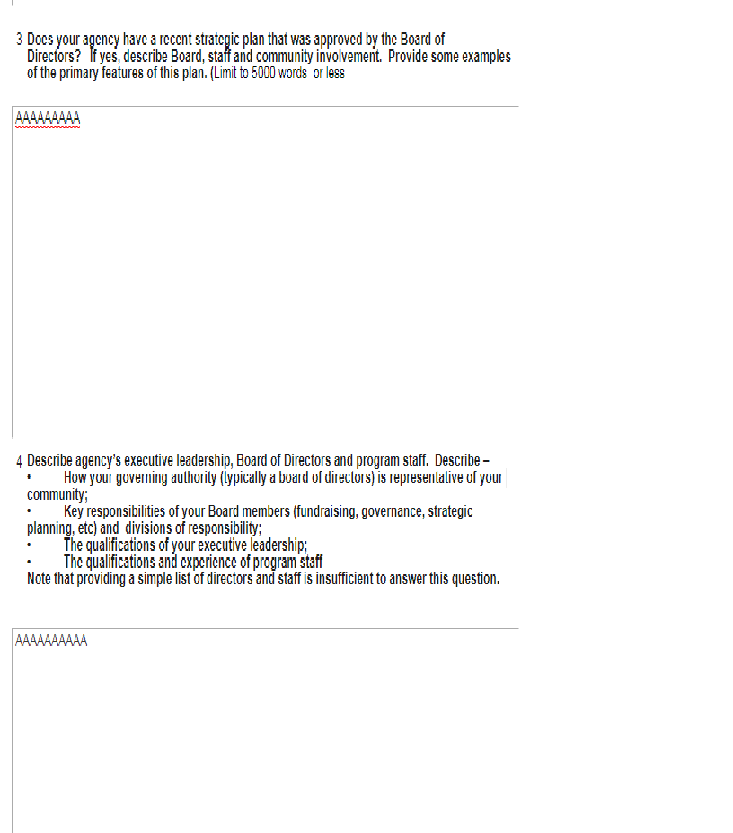
Organizational Narrative Cont’d

Slide 14
Organizational Narrative Cont’d

Slide 15
Contact Information

Slide 16
Organizational and Contact Information
Complete all fields
DUNS (format xxx-xxx-xxx) and EIN (format xx-xxxxxxx) are different!
Contact information should be complete as this information is used to contact the appropriate persons when disseminating information
DV Agencies, please note information regarding street address/P.O. Box

Slide 17
Board Members

Slide 18
List of Board Members
Complete each field –
*”Term of office” is not length of service but rather the stated term in the Articles of Incorporation or the organization’s By-Laws for the Board Member
*”Qualification” may include advocacy or expertise related to the Board Member’s profession or in the non-profit/homeless arena. An example might be an Educator that is/has been the liaison for homeless children/families in a school system
*”Ethnicity” for this purpose will be Hispanic or non-Hispanic
* Board member list will accept more than one board member
*”Homeless/Formerly Homeless” - see requirements on next slide

Slide 19
Homeless Participation on the Board of Directors or other equivalent policy making entity
§ 576.405 Homeless participation.
(a) Unless the recipient is a State, the recipient must provide for the participation of not less than one homeless individual or formerly homeless individual on the board of directors or other equivalent policymaking entity of the recipient, to the extent that the entity considers and makes policies and decisions regarding any facilities, services, or other assistance that receive funding under Emergency Solutions Grant (ESG).
(b) If the recipient is unable to meet requirement under paragraph (a), it must instead develop and implement a plan to consult with homeless or formerly homeless individuals in considering and making policies and decisions regarding any facilities, services, or other assistance that receive funding under Emergency Solutions Grant (ESG). The plan must be included in the annual action plan required under 24 CFR 91.220.
(c) To the maximum extent practicable, the recipient or sub-recipient must involve homeless individuals and families in constructing, renovating, maintaining, and operating facilities assisted under ESG, in providing services assisted under ESG, and in providing services for occupants of facilities assisted under ESG. This involvement may include employment or volunteer services.

Slide 20
Articles of Incorporation
Original Articles of Incorporation as submitted to the Secretary of State’s Office at the time of Incorporation (should be stamped by the SoS office with date).
Articles of Incorporation may be “Re-Stated” if the organization has changed its name or some component of the Original Articles of Incorporation (should also be stamped by the SoS office with date).
ONLY Articles of Incorporation should be uploaded to the category.
*Not applicable for units of local government, quasi-state organizations

Slide 21
Upload Page

Slide 22
Certificate of Incorporation
This document is issued by the Secretary of State at the time of incorporation, certifying that an organization “has been duly incorporated under the laws of the State of Georgia on the effective date….by the filing of Articles of Incorporation in the office of the Secretary of State …..”
ONLY Certificate of Incorporation should be uploaded to the category.
This is also called “Certificate of Existence.” You purchase thru Secretary of State website for a $10 fee. Please refer to this link https://ecorp.sos.ga.gov/
*Not applicable for units of local government, quasi-state organizations
*Not the same as the Annual Registration with the Secretary of State’s office (we will confirm current status with the registration and no action is necessary by the applicant)

Slide 23
501(c)3 Determination Letter
This is a “threshold” determinant - without this final determination (with the exception below, local governments and quasi-state organizations) organizations will not be considered for funding.
*Not applicable for units of local government, quasi-state organizations

Slide 24
Financial Procedures Manual
At a minimum, this policy manual should include information regarding –
Internal Controls/Financial Oversight
Accounts Payable procedures
Accounts Receivable procedures
Procurement
Basis of Accounting and Financial Statement preparation
Budgeting
Grants Management
Do NOT submit a Personnel Manual or Employee Handbook

Slide 25
Minutes of Last 3 Board Meetings
Should be recent and in accordance with a schedule specified in the Articles of Incorporation or organization’s By-Laws (monthly, quarterly, etc)
Gives a snapshot of the participation of the Board Members as well as how business is conducted
Three sets of minutes are required! Meetings should have taken place in calendar year 2017 or early 2018.

Slide 26
List of Organizational Staff
Include list of current program staff, support staff (might include financial staff), as well as, the upward chain of management
Must include both name and position
Do NOT send an organizational chart

Slide 27
Staff Job Descriptions
Must include Position Job Description
Time Distribution Analysis – percentage of time spent in support of activities
Level of Compensation
*Complete ONLY if requesting DCA funding to support staff positions

Slide 28
IRS Form 990
All other non-profit organizations (as required) must submit Form 990 by the 15th day of the 5th month following the end of the fiscal year.
Example 1 – fiscal year end 12/31 – due May 15
Example 2 – fiscal year end 6/30 - due November 15
Example 3 – fiscal year end 9/30 – due February 15
For Part 1 submission purposes, using the above examples, Examples 2 and 3 Forms 990 for the period ending 6/30/17 and 9/30/17 should be available for upload. Form 990 for Example 1 may or may not be available as it is not due until May 15, 2018. If not available, Form 990 for the period ending 12/31/16 is appropriate for upload.
*Not applicable for local governments, certain religious organizations, quasi-state organizations

Slide 29
Required Financial Statements
(Read Georgia Code (O.C.G.A.), Title 50, Chapter 20)
Organizations that expend greater than $100,000 in state funds must submit (independently) audited financial statements

Slide 30
Required Financial Statements
Organizations that expend less than $100,000 in state funds must (at a minimum) submit the following –
Statement of Financial Position
Statement of Activities (including an analysis of sources of revenue)
Statement of Cash Flows
Schedule of State Awards Expended
If annual financial statements are reported upon by a public accountant, the accountant's report must accompany them. If not, the annual financial statements must be accompanied by the statement of the president or person responsible for the nonprofit organization's financial statements: (A) Stating the president's or other person's belief as to whether the statements were prepared on the basis of generally accepted accounting principles and, if not, describing the basis of preparation; and (B) Describing any respects in which the statements were not prepared on a basis consistent with the statements prepared for the preceding year.

Slide 31
Organizational Documentation
If you can’t advance from the Registration to the confirmation page, it means that some fields still need to be entered.
If you need to update the Registration after initial submission, you can do so via the Org Doc home page.
ALL organizational documents MUST be completed in their entirety.

Slide 32
Document Orientation
Please ensure that uploaded documents are “oriented” properly, not upside-down, not sideways. View your upload and if not “oriented” properly, delete, and reload correctly.

Slide 33
Thank You
Thank you for your attention and participation!
Please visit our website at:
https://dca.ga.gov/safe-affordable-housing/homeless-special-needs-housing
for additional information about the Emergency Solutions Grant, HOPWA, and S+C Programs

Slide 34
2018-2019 EMERGENCY SOLUTIONS GRANT PROGRAM
March 2018
Marion Goulbourne

Slide 35
Emergency Solutions Grant (ESG)
Application Process

Slide 36
ESG Program Purpose
The revised Emergency Solutions Grants (ESG) program and regulation:
“…maintains support for a crisis response system through emergency shelters, but places an emphasis on identifying and preventing homelessness and returning those who experience homelessness back into the community as quickly as possible.”

Slide 37
ESG Policy Requirements
A greater level of collaboration between ESG entitlements and Continua of Care (CoCs).
A results-oriented approach with a greater emphasis on the Housing First approach.
A minimum of 40% of DCA ESG funds must be spent for homelessness prevention and rapid re-housing.
If you serve families, you must serve ALL families!
No Federal funding is available for Transitional Housing projects.
Continua of Care must establish and enforce performance criteria for ESG projects.
All ESG projects must utilize the coordinated entry system designated by the CoC for the geographic location of each project.

Slide 38
Eligible Applicants
Local or regional entities; including nonprofits (secular and faith-based), local governments, local government entities (community service boards, etc.) and authorities, community action agencies.
Nonprofit applicants for emergency shelter must receive approval of local government(s) where the project is located.
Nonprofit applicants, including religious organizations, must have 501(c)(3), provide programs in a manner free from religious influences, and meet threshold and ongoing viability standards established by DCA (as required by state law).

Slide 39
Minimum and Maximum Funding Awards by Project Type
Type of Funding | Minimum – Maximum Award Amounts
Emergency Shelter | $30,000 - $60,000
Supportive Services | No minimum - $25,000
Prevention | $30,000 – no limit
Rapid Re-Housing | $30,000 – no limit
Street Outreach | $30,000 - $50,000
Hotel/Motel | no minimum - $60,000
HMIS | no minimum - $45,000
Minimum and maximum award amounts are subject to change from year to year.

Slide 40
Who is Homeless?
4 CATEGORIES:
(1) Individuals and families who lack a fixed, regular, and adequate nighttime residence and includes a subset for an individual who resided in an emergency shelter, or a place not meant for human habitation and who is exiting an institution where he or she temporarily resided;
(2) individuals and families who will imminently lose their primary nighttime residence (within 14 days);

Slide 41
Who is Homeless? (cont.)
(3) unaccompanied youth and families with children and youth who are defined as homeless under other federal statutes who do not otherwise qualify as homeless under this definition; but who meet the following criteria:

Slide 42
Who is Homeless? (cont.)
Category 3 (continued)
Have not had a lease, ownership interest, or occupancy agreement in permanent housing at any time during the 60 days immediately preceding the date of application for homeless assistance;
Have experienced persistent instability as measured by 2 moves or more during the 60-day period immediately preceding the date of application; AND
Can be expected to continue in such status for an extended period of time because of chronic disabilities, chronic physical health or mental health conditions, substance addiction, histories of domestic violence or childhood abuse (including neglect), the presence of a child or youth with a disability, or two or more barriers to employment, which include the lack of a high school degree or General Education Development (GED), illiteracy, low English proficiency, a history of incarceration or detention for criminal activity, and a history of unstable employment.
NOT APPLICABLE IN THE STATE OF GEORGIA

Slide 43
Who is Homeless? (cont.)
(4) individuals and families who are fleeing, or are attempting to flee, domestic violence, dating violence, sexual assault, stalking, or other dangerous or life-threatening conditions that relate to violence against the individual or a family member.”

Slide 44
Who is Chronically Homeless?
An “individual” or “family” that is …
is currently homeless and lives or resides in a place not meant for human habitation, a safe haven, or in an emergency shelter; and
has been homeless and living or residing in a place not meant for human habitation, a safe haven, or in an emergency shelter continuously for at least 1 year OR on at least 4 separate occasions in the last 3 years, as long as the combined occasions equal at least 12 months and each break in homelessness separating the occasions is at least 7 consecutive nights of not living as described in paragraph (1) ; and
has an adult head of household (or a minor head of household if no adult is present in the household) with a diagnosable substance use disorder, serious mental illness, developmental disability [as defined in section 102 of the Developmental Disabilities Assistance and Bill of Rights Act of 2000 (42 U.S.C. 15002)], post-traumatic stress disorder, cognitive impairments resulting from a brain injury, or chronic physical illness or disability, including the co-occurrence of 2 or more of those conditions
Persons who were chronically homeless at entry remain chronically homeless at exit, if an institutional stay is less than 90 days.

Slide 45
Who is At-Risk of Homelessness?
(1) The household has income below 30 percent of area median income (AMI) for the geographic area; AND
(2) the individual or family has insufficient resources immediately available to attain housing stability.
sufficient resources or support networks are:
family, friends, or faith-based or other social networks immediately available to prevent them from moving to a shelter or living outside

Slide 46
Who is At-Risk of Homelessness? (cont.)
AND:
Meets one or more of following:
Moved frequently for economic reasons
Living with others due to economic hardship
Notice of eviction (within 21 days)
Living in hotel/motel (at own cost)
Living in overcrowded housing (as defined by HUD)
Exiting an institution
Otherwise lives in housing that is unstable (as defined by DCA)
Families with children, and youth defined as homeless under other Federal statutes.

Slide 47
Applications Will Not Be Considered
The deadline is missed.
HMIS or DV comparable database non-participation.
Application substantially incomplete.
Ineligible applicant – lacks 501(c)(3).
New organizations should have been in business and fully operational for 2 years and able to produce minimum financial statements and filings with the IRS for that period, financial policies and procedures, program policies and procedures.
Failure to obtain Local Approval or Certification of Consistency, as applicable.
Serving ineligible populations (not homeless by HUD definition and verification standard).

Slide 48
Applications Will Not Be Considered
Insufficient or ineligible match amount or source.
Non-compliance with coordinated entry.
Use of projected project income or client fees as a match source.
For DV agencies, a failure to submit HUD Annual Performance Report (APR) for entire prior or current program year by application deadline.
Inability to keep families intact for service.
Inability to abide by all Equal Access and LEP requirements.
*See Application Guidelines for complete information.

Slide 49
Scoring and Award Factors
Poor performance in any of these areas negatively affects scores and awards amounts:
Completeness of the grant application
Use of reputable data to describe need (homeless counts), clients served, local coordination, goals, outputs, outcomes, etc.
CoC or ESG Entitlement priorities
Efficient and effective use of HMIS, adherence to HMIS policy and procedures, and ability to deliver data of high quality
Adherence to DCA Housing Support Standards
Staffing and match levels promote ability to serve number of participants projected
Organizational experience, capacity, and stability, including
Capacity and oversight of Board of Directors
Budgeting and financial reporting
*See Application Guidelines for complete information.

Slide 50
Scoring and Award Factors
Agency participation in:
CoC Planning
Homeless Count
DCA-sponsored trainings for current ESG subgrantees
Ability to design and successfully manage project under current regulations and priorities for the overall ESG program
Project and agency performance including --
Monitoring compliance
Compliance with HMIS or DV comparable database policies and procedures
Ability to meet project requirements and goals successfully
Ability to spend past grant awards in timely manner
Increases in income and benefits during project enrollment
Exits to permanent destinations
Returns to homelessness

Slide 51
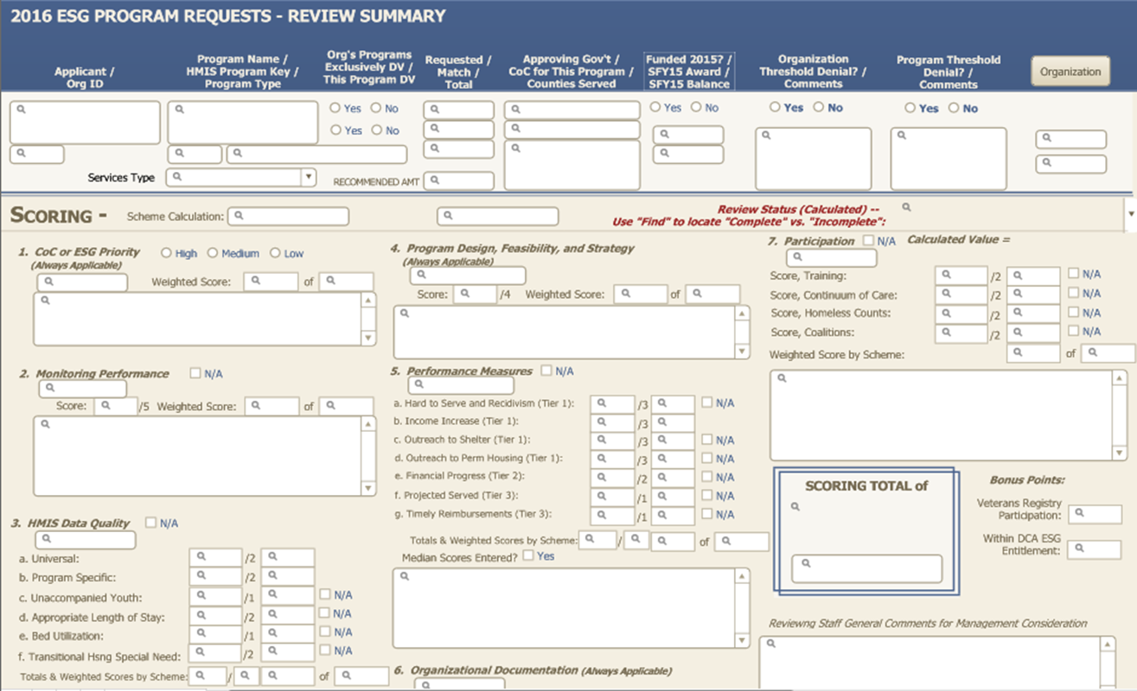
Application Scoring-DCA Database

Slide 52
Match Requirements
All applicants must provide at least a 100% match consisting of documented non-McKinney resources.
Is PROJECT-specific, must benefit recipients of project in application.
In addition to cash, match may include the value of any lease on a building, the actual value of professional services, any salary paid to staff to carry out the project, and the value of volunteer hours. The latter should equal the cost necessary to provide the services in question.

Slide 53
HUD Consolidated Plan Consistency
All applicants proposing projects located within the 22 local HUD Consolidated Plan jurisdictions must obtain “Certification of Consistency” with local plans from local government officials.
Local Consolidated Planning jurisdictions include the cities of Albany, Atlanta, Brunswick, Dalton, Gainesville, Hinesville, Johns Creek, Macon, Rome, Sandy Springs, Savannah, Valdosta and Warner Robins, the counties of Cherokee, Clayton, Cobb (including Marietta), DeKalb, Fulton (including Roswell), Gwinnett and Henry, and the consolidated governments of Athens-Clarke, Augusta-Richmond and Columbus-Muscogee.
Forms will be posted on ESG webpage.

Slide 54
Deadlines- Important Dates
Online application system opens Thursday, March 8
System registration closes Thursday, March 29 at 5:00 pm
All content is due on Monday, April 16 at 5:00 pm
The link to Housing Solutions Online will be sent to the DCA list serve, and posted on the ESG website on Thursday, March 8, 2018.
Links and Supporting materials will be posted on ESG main webpage:
https://dca.ga.gov/safe-affordable-housing/homeless-special-needs-housing/emergency-solutions-grants
Paper submissions will NOT be accepted.

Slide 55
2018 Applications
There are 7 applications:
Emergency Shelter
Supportive/Essential Services
Homelessness Prevention
Rapid Re-Housing
Street Outreach
Hotel/Motel Vouchers
HMIS

Slide 56
General Instructions – All Applications
Include organization’s legal name and contact information.
Include project name – this MUST be consistent with HMIS.
APRs from DV agencies must include project name or type.
List sites consistent with sites from organizational submissions.
Name local approving and consolidated planning jurisdictions, as applicable.
Read manual (Application Guidelines) for details on projects, process, requirements.
Be sure to answer all (sub)questions of application questions.

Slide 57
Application I-Emergency Shelter
Focus on ensuring a positive housing outcome to permanent housing.
Ensure high bed utilization by eliminating barriers/requirements to entry.
Shelters that serve families must serve all eligible families and may not refuse services based on the age of children, size of the family, marital status, or family composition.
May apply for $30,000 - $60,000 per project.

Slide 58
Emergency Shelter
Shelter Operations
Costs to operate and maintain emergency shelters and
also provide other emergency lodging when appropriate.
Rent Food
Furnishings Security
Fuel Insurance
Utilities Equipment
Maintenance Hotel or motel voucher

Slide 59
Emergency Shelter
Shelter Services
Services provided to shelter program participants.
Case Management Child Care
Life Skills Substance Abuse Treatment
Legal Services Services
Mental Health Services Services for Special Populations
Education Services Outpatient Health Services
Transportation Employment Assistance and Job Training

Slide 60
Application III-Supportive Services
Service projects must be directly connected to projects moving clients into permanent housing.
ONLY proscribed types of services are eligible for funding.
Must follow all ESG requirements:
Utilize the coordinated entry instrument established by the Continuum of Care.
Required to enroll participants into projects in HMIS.
Up to $25,000 per project.
Limit 1 services application per agency.
Only 1 Service type per application allowed.

Slide 61
Supportive Services
Eligible activities are limited to:
Employment training and services
Transportation
Aftercare case management for clients exiting Emergency Shelters for permanent housing
Child care
SSI/SSDI Outreach And Recovery benefits services (SOAR)
(Applications must clearly identify the activity requested for funding.)

Slide 62
Applications IV and V Prevention and Rapid Re-Housing
Financial Assistance
Moving costs
Rent application fees
Security deposit
Last month's rent
Utility deposit
Utility payments
Rental assistance
Housing Relocation and Stabilization Services
Housing Search & Placement
Housing Stability Case Management
Mediation
Legal Services
Credit repair

Slide 63
Rapid Re-Housing and Prevention
Participants can be assisted for up to 1 year. Length of stay to be determined based on household need.
Agencies are required to:
provide case management services to participants at least monthly
re-certify participant eligibility at least every 90 days
establish a formal plan for long-term stability for each participant at discharge, and
follow up post discharge
Proposed budgets should include a reasonable ratio of client financial assistance to housing relocation and stabilization services.
Applications should include reasonable ratio of households served to funding amount requested.
The minimum award amount will be $30,000.

Slide 64
Application IV-Homelessness Prevention
Follow HEARTH definition of “at risk” for eligibility
Or CATEGORY 2 of homeless definition
persons who will imminently lose their primary nighttime residence within 14 days
Services to households facing eviction from housing they rent.
Client must have lease in name.
Stabilize households in existing homes and ensure that participants can remain in their housing for the longer term.
If remaining in existing home is not possible, relocation assistance to appropriate housing can be provided.
DCA will not fund duplicative efforts.

Slide 65
Application V-Rapid Re-Housing
Housing is not the end of the process… it’s the beginning.
Provide services to move literally homeless participants into permanent housing to remain there for the long term.
RRH providers should be attached to Street Outreach efforts, Emergency Shelters, and other community supports and services to identify participants.
Case management and consistent follow up are essential.
Can be a regional or local implementation.

Slide 66
Application VI- Street Outreach
Eligible activities include:
Engagement
Case Management
Emergency Health Services
Emergency Mental Health Services
Transportation
Services to Special Populations (Essential Services during outreach)

Slide 67
Street Outreach
Use unsheltered homeless data for your county from Georgia’s 2017 Point-In-Time Count.
Describe specific street populations you intend to serve, including the geographic locations where Outreach teams will engage clients.
Outreach should use housing-first approach -
Focused on moves into permanent housing, rather than alleviating the difficult conditions they experience on the street. (This is not a mobile feeding program.)
The bulk of the funding will be for engagement and case management, rather than provide emergency services.
Funding will be prioritized to areas where PATH teams do not exist.
Street Outreach projects can apply for $30,000 - $50,000 per project.

Slide 68
Application VII-Hotel/Motel Vouchers
Exclusively for homeless clients who need immediate housing and NO APPROPRIATE shelter is available.
Will have to provide evidence/justification about shelter availability
Intended primarily for clients served by RRH and outreach projects.
Can be used for challenges such as:
Time of placement
Households with special needs
High barrier clients that will be turned away from current shelters
No shelter available for participants who have been through coordinated assessment
Short stays until preferred housing option becomes available; no longer than 30 days.
Case management service dollars available.
Up to $60,000

Slide 69
Application VIII-HMIS
Costs of contributing data to Eccovia ClientTrack or DV comparable database (designated by DCA).
Eligible costs may include: software, data entry, limited assistance obtaining HMIS technical assistance and training, and user fees.
Reserved for BoS CoC or DCA ESG Entitlement areas.
For emergency shelters, rapid re-housing or prevention projects.
Projects with large implementations; those serving a high volume of clients, etc.
Up to $45,000

Slide 70
HMIS Requirements
Increased importance placed on HMIS in application review process AND performance measurements of successful applicants.
If you want to have a competitive application this year, make certain your data is accurate and complete. It will also be used to evaluate performance!
A lack of data will also hurt your application
Data will be taken directly from HMIS by DCA.
If your agency or project names in HMIS are inconsistent with what you provided in your application, we may not find it or fund it.
Domestic violence agencies currently receiving ESG funds must submit HUD APR from 7/1/2017 through 2/28/2018 for scoring.

Slide 71
Housing First
The Housing First approach prioritizes placement in permanent housing over therapeutic outcomes.
Housing First projects will have low barriers to entry and participation.
Housing First projects will focus on permanent housing placement as quickly as possible.
Projects demonstrating a commitment to the Housing First approach will be prioritized.

Slide 72
Housing Support Standards
Ensure that quality case management takes place and include (among other requirements):
Common assessment
Establish and track client progress and goals
90-day post-discharge follow-up contacts
ALL ESG subgrantees, (including service only projects), must adhere to.
Many related activities and outcomes are tracked in ClientTrack.

Slide 73
Required Training
Current ESG subgrantees are required to participate in DCA-sponsored training.
Failure to comply will affect application scores.
Includes topics such as, but not limited to:
ESG Implementation and Administration
Housing First
Georgia Housing Search
Training specific to program type

Slide 74
Housing Solutions Online Application System

Slide 75
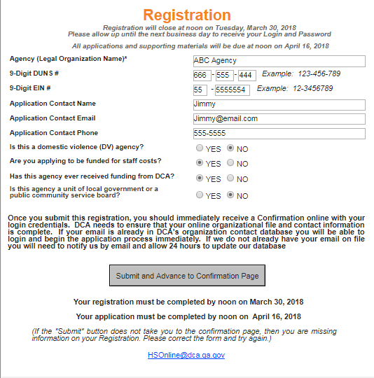
Registration

Slide 76
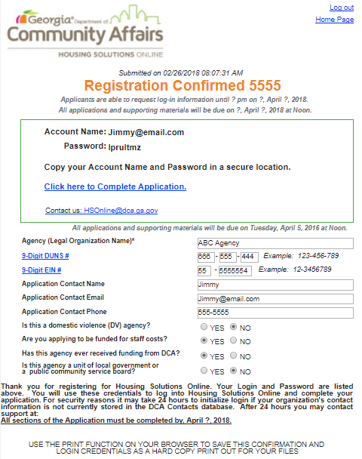
Registration Confirmed

Slide 77
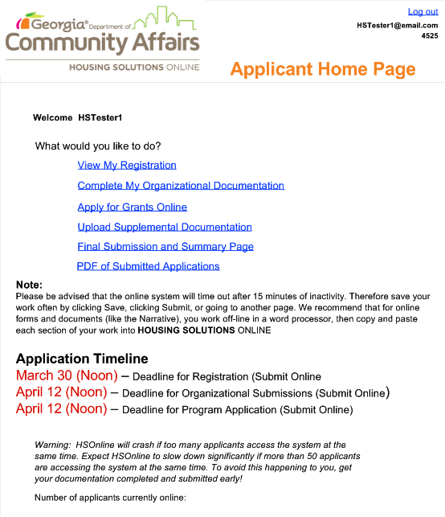
Home Page

Slide 78
Housing Solutions Online (HSO)
An email will be sent to the DCA list serve when HSO is open. The link to HSO will also be posted on the ESG website.
You will have until Thursday, March 29, 2018 to request log-in information.
You will have about 6 weeks to complete and upload all required documents, including completed applications.
After each session, click “log out” instead of simply closing the window. Otherwise, you might have technical difficulties when you log in next time and you will slow the system down for other users.

Slide 79
Housing Solutions Online (HSO) (cont.)
All applications will be completed in HSOnline system.
Users will be able to save work and log back in later to complete an application.
It will be more important than ever to log out when session is complete.
Multiple simultaneous users may create technical challenges.

Slide 80
Hints
DO NOT wait until the last minute.
It can take up to 24 hours to receive your login and password via email.
Users will also receive a pop-up message with login and password.
The system can become very slow when many applicants are logged on at the same time.
Add HSOnline@dca.ga.gov to your address book so that the login email isn’t flagged as spam.

Slide 81
More Hints
Required documents are uploaded individually.
This gives applicants another chance to verify they have all the correct documents uploaded before submitting.
Certification of Consistency and Local Approval forms will be uploaded into the upload panel of HSOnline.

Slide 82
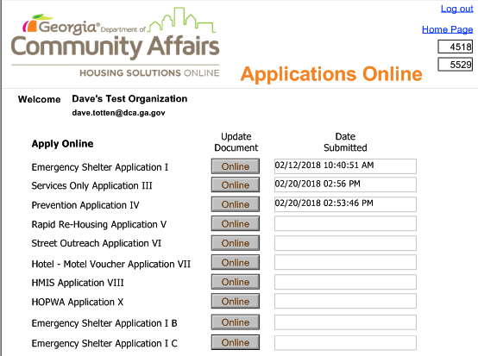
Applications Online

Slide 83
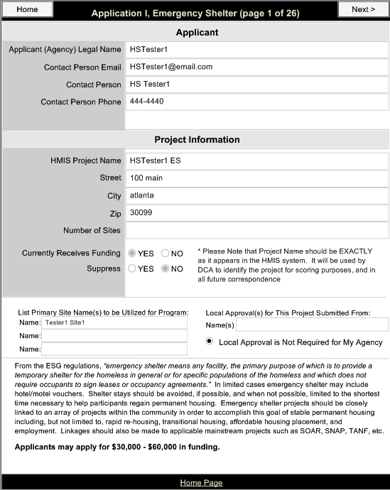
Emergency Shelter page 1 of 26

Slide 84
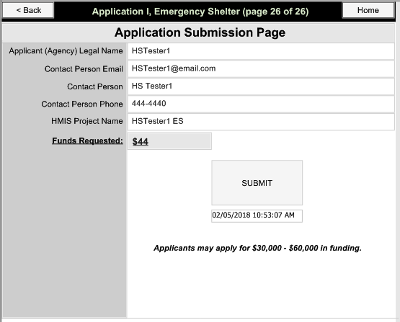
Emergency Shelter Submit Page

Slide 85
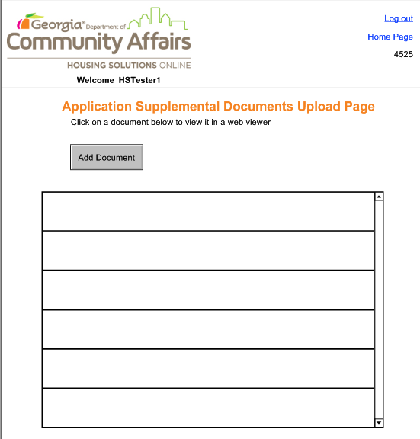
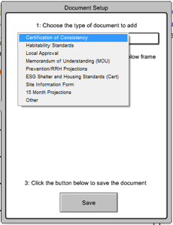
Supplemental Documents Upload

Slide 86
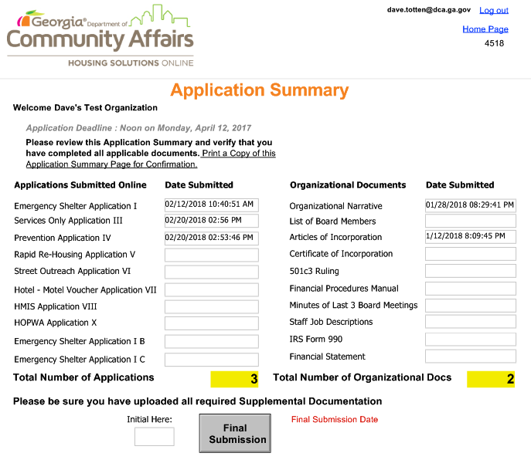
Application Summary Final Submission

Slide 87
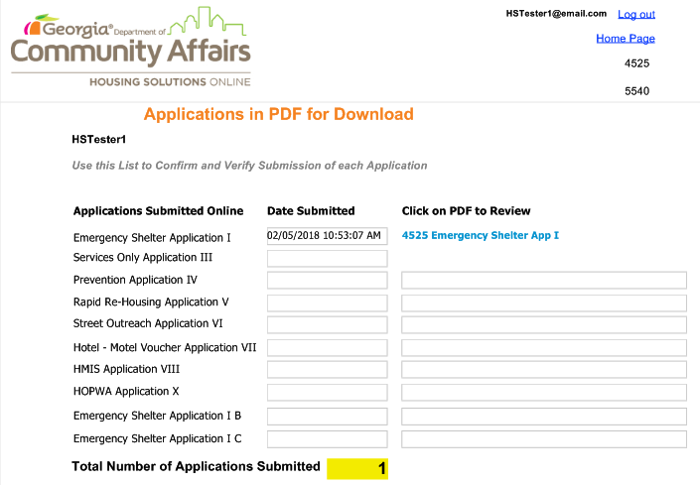
Application in PDF for Download

Slide 88
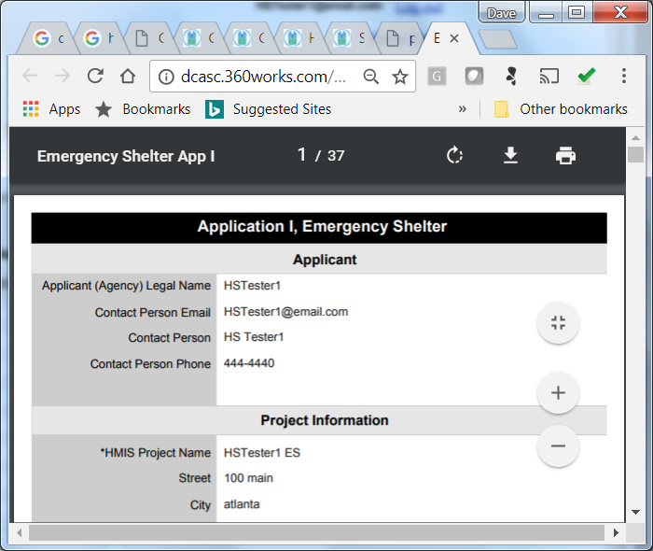
Please Allow 5 minutes for Rendering

Slide 89
Application in PDF for Download

Slide 90
Rapid Re-Housing and Prevention15-Month Projections
Clients Served projections should only include new clients each month. The totals should equal the annual total for the project.

Slide 91
DCA Application Technical Assistance Webinars
Applications and Organizational Documentation
DCA will conduct an application workshop via webinar.
Thursday, March 8, 9:00 am – 12:00 pm
Application Q&A
DCA will conduct webinars to answer questions concerning the applications.
Webinar registration will be available on the ESG webpage.

Slide 92
Fair Housing
It is the policy of the Georgia Department of Community Affairs (DCA) to comply fully with all federal, state, and local nondiscrimination laws and to operate in accordance with the rules and regulations governing Fair Housing and Equal Opportunity in housing and employment. Specifically, DCA shall not on account of race, color, sex, religion, national origin, family status, disability or age deny any family or individual the opportunity to apply for or receive assistance under HUD's Program.

Slide 93
Homeless Participation
To the maximum extent practicable (see also conflicts of interest prohibitions), grantees must involve homeless individuals and families in constructing, renovating, maintaining, and operating facilities assisted under ESG, in providing services assisted under ESG, and in providing services for occupants of facilities assisted under ESG.
This involvement may include employment or volunteer services.

Slide 94
Affirmative Outreach
…grantees must make known that use of the facilities, assistance, and services are available to all on a nondiscriminatory basis. If it is unlikely that the procedures that the grantee intends to use to make known the availability of the facilities, assistance, and services will reach persons of any particular race, color, religion, sex, age, national origin, familial status, or disability who may qualify for those facilities and services, grantee must establish additional procedures that ensure that those persons are made aware of the facilities, assistance, and services.

Slide 95
Language Barriers
…ensure effective communication with persons with disabilities including, but not limited to, adopting procedures that will make available to interested persons information concerning the location of assistance, services, and facilities that are accessible to persons with disabilities. Consistent with Title VI and Executive Order 13166, grantees are also required to take reasonable steps to ensure meaningful access to programs and activities for limited English proficiency (LEP) persons.

Slide 96
Shelter Plus Care Support Services
Application Process

Slide 97
Shelter Plus Care Support Services
Organizational Review Requirement – same as for ESG.
S+C Support Services Application – All current S+C agencies will receive an email on 3/8/18 with the link to the application. We will be using the same format as last year through Constant Contact.
Both the Organizational documents (HSonline) and the Application (Constant Contact) are DUE April 16, 2018 by NOON.

Slide 98
S+C Support Service Eligible Activities
Eligible categories are the same:
Case Management
Furniture
Turnkey
Client Transportation
Training
Client Assistance

Slide 99
Shelter Plus Care Support Services
S+C programs that have services funded through HOPWA are not eligible for S+C Support Services funding. Instead, your HOPWA funding can pay for these line items.
Only one Support Services grant per agency.
The maximum amount will be tiered depending on the size of the agency portfolio – those sponsors with 50 units or less may apply for a maximum award of $20,000
Sponsors with more than 50 units may apply for a maximum award of $25,000.

Slide 100
S+C Harm Reduction Case Management
No new funding for Harm Reduction Case Management this year.
Currently funded grantees will receive an application to complete.
Watch for more information via email on 3/8/18.

Slide 101
Shelter Plus Care
All current S+C sponsors should have received an email introducing the application process.
One webinar will be held on Monday, 3/12/18 to answer questions about this application process.
Details will be emailed to S+C sponsors on 3/8/18.
Please contact Libby Tyre for further details
at libby.tyre@dca.ga.gov

Slide 102
Housing Opportunities for Persons with AIDS (HOPWA)
Application Process

Slide 103
Housing Opportunities for Persons with AIDS (HOPWA)
The Georgia Department of Community Affairs (DCA) seeks proposals from eligible service providers to provide HOPWA assistance to Persons living with HIV/AIDS (PLWHA) and persons in their family.
Approximately $2.5 million dollars will be available.
Funds will be available to provide HOPWA services in 126 counties under DCA HOPWA jurisdiction outside of City of Atlanta and Augusta-Richmond HOPWA jurisdiction.

Slide 104
DCA HOPWA Service Areas

Slide 105
Eligible Funding Activities
Facility-Based Housing (FBH) Assistance
FBH, S+C Support, Hotel/Motel Vouchers, Short-term/Transitional Housing
Tenant-Based Rental Assistance (TBRA)
Short-Term Rent, Mortgage and Utility (STRMU) Assistance
Permanent Housing Placement (PHP)
Supportive Services
Housing Information and Referral Services
Resource Identification

Slide 106
Remember…..
Participation in HMIS is required.
Housing First model practice is strongly encouraged.
Participation in Coordinated Entry System and local Continuum of Care is strongly encouraged.
Leverage with other care services and funding is strongly encouraged.

Slide 107
2018 HOPWA Application
Application Deadline – Same as ESG
The application process will open on
Thursday, March 8, 2018
Applicants may request log-in information until
Thursday, March 29, 2018 at 5pm
Deadline for submitting HOPWA application is
Monday, April 16, 2018 at 5pm
Late applications will not be considered

Slide 108
2018 HOPWA Application
DCA will conduct a Application Workshop Webinar to provide applicants with additional information
Thursday, March 8, 2018
9 am – 12 pm

Slide 109
2018 HOPWA Application
For more information about the HOPWA program please visit our website at:
https://dca.ga.gov/housing/homeless-special-needs-housing/housing-opportunities-persons-aids-hopwa

Slide 110
2018 HOPWA Application
Questions or concerns about the HOPWA application process? Please contact:
Dr. Harvinder K Makkar
Harvinder.makkar@dca.ga.gov
470.382.3518
John Shereikis
John.Shereikis@dca.ga.gov
470.747.9331

Slide 111
Thank You
Thank you for your attention and good luck!
QUESTIONS?

